Slide 1
Applications

Slide 2
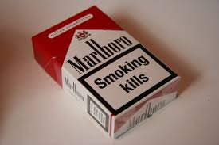
Relation between Smoking and Lung Cancer

Slide 3
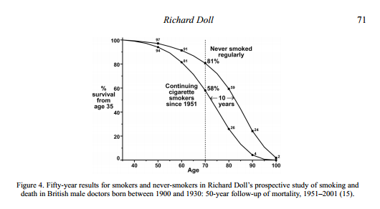
In 1950 Sir Richard Doll ,an epidemiologists along with his partner Sir Bradford Hill

Slide 4
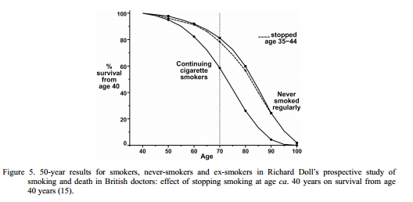

Slide 5
Applications of Linear Regression
Evaluating Trends and Sales Estimates
if a company's sales have increased steadily every month for the past few years
linear analysis on the sales data with monthly sales on the y-axis and time on the x-axis
After creating the trend line, the company could use the slope of the line to forecast sales in future months

Slide 6
Analyzing the Impact of Price Changes
if a company changes the price on a certain product several times
it can record the quantity it sells for each price level and then perform a linear regression
The result would be a line that depicts the extent to which consumers reduce their consumption of the product as prices increase

Slide 7
Assessing Risk
a health insurance company conducts a linear regression
plotting number of claims per customer against age
older customers tend to make more health insurance claims

Slide 8
Application of LWL
Calibration of Imaging System
A novel non-parametric non-linear homography formulation that can map lines on the source plane to arbitrary smooth curves on the target plane
compare the use of both parametric
polynomial models and non-parametric Gaussian process
models of lens distortion
Improved stability of camera calibration

Slide 9
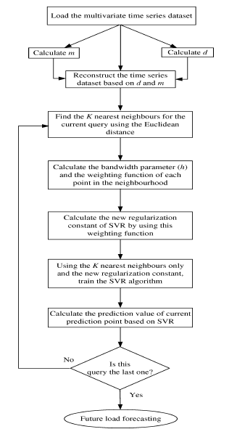
Electric Load Forecasting

Slide 10
Autonomous helicopter flight via Reinforcement Learning
a human pilot to fly the helicopter for several minutes
12-dimensional helicopter state and 4 dimensional helicopter control inputs
339 seconds of flight data for model fitting, and another 140 seconds of data for hold-out testing
In response to a query, LWL regression makes the prediction

Slide 11
Betting System
In 2012, the online sports betting industry was projected to be worth $13.9 billion
approximately $7 billion wagered on soccer alone
Sky bet, Bet365, BetVictor , Betfred, 10Bet

Slide 12
Bookmakers take advantage of human preference for risk
irrational team loyalty of fans in the face of poor odds
A soccer bettor prefer to minimize risk

Slide 13
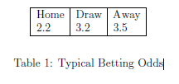
It is a 3-class classication problem on the ordered outcomes {HomeWin;Draw; AwayWin}
Any formula used to determine the optimal size of a series of bets?

Slide 14
Datasets
Frequency counts of in game events from the 2011-2012 PL season, such as tackles, shots, yellow cards, and more, recorded for each player individually.
whole team, including overall performance in previous matches.
The capacity of the team's stadium, from the Premier League Handbook
The location in latitude and longitude of the team's stadium

Slide 15
team's performance in the previous season
total amount paid in player wages in the previous season
The total cost in transfer fees of the team's squad as of September 2011
manager's performance

Slide 16
Dataset from Opta
Manchester City Football Club in cooperation with OPTA made an extensive dataset for the 2011-2012 EPL season publicly
unique opportunity to explore this resource with the use of suitable techniques to gain insight into the evaluation of player and team performances.

Slide 17
210 attributes and 10369 instances
we break our dataset in four parts:
an attackers dataset
a defenders dataset
a midfielders dataset
a goalkeepers dataset
Any attributes most relevant to each dataset?

Slide 18
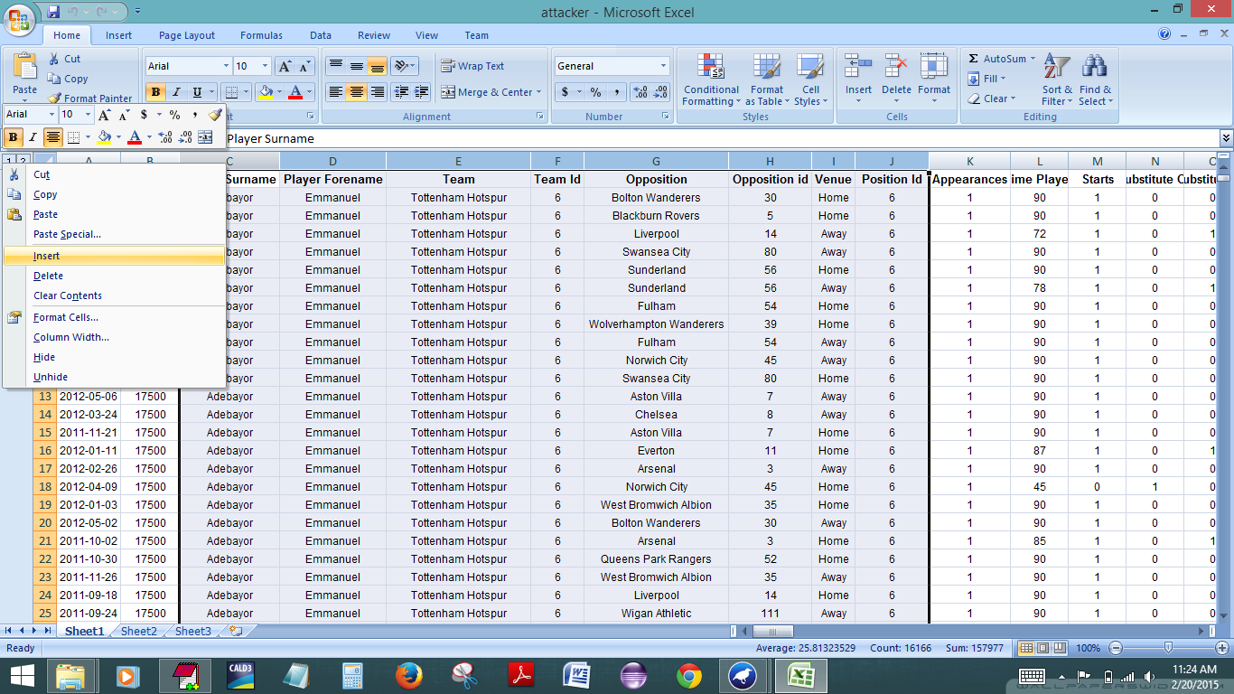

Slide 19
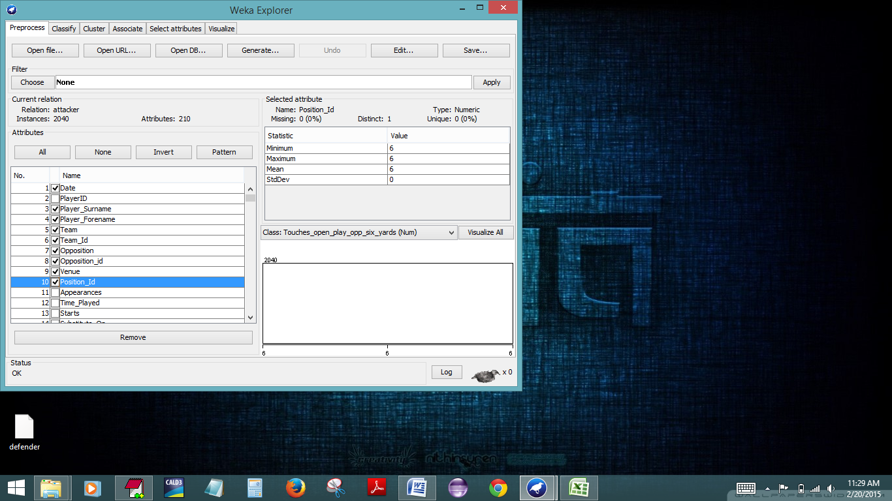

Slide 20
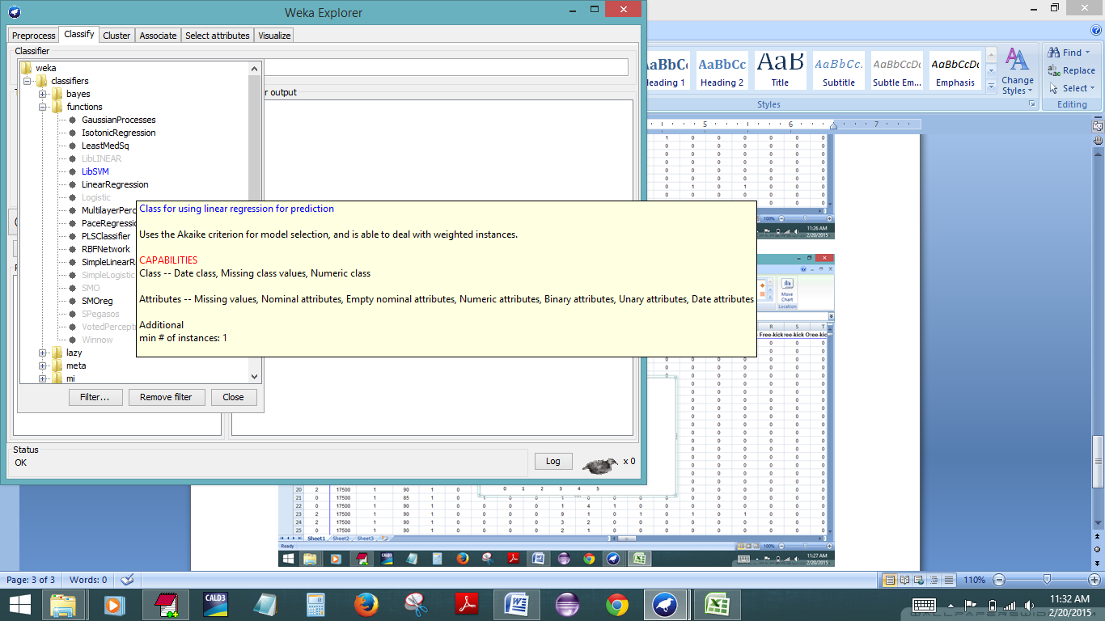

Slide 21
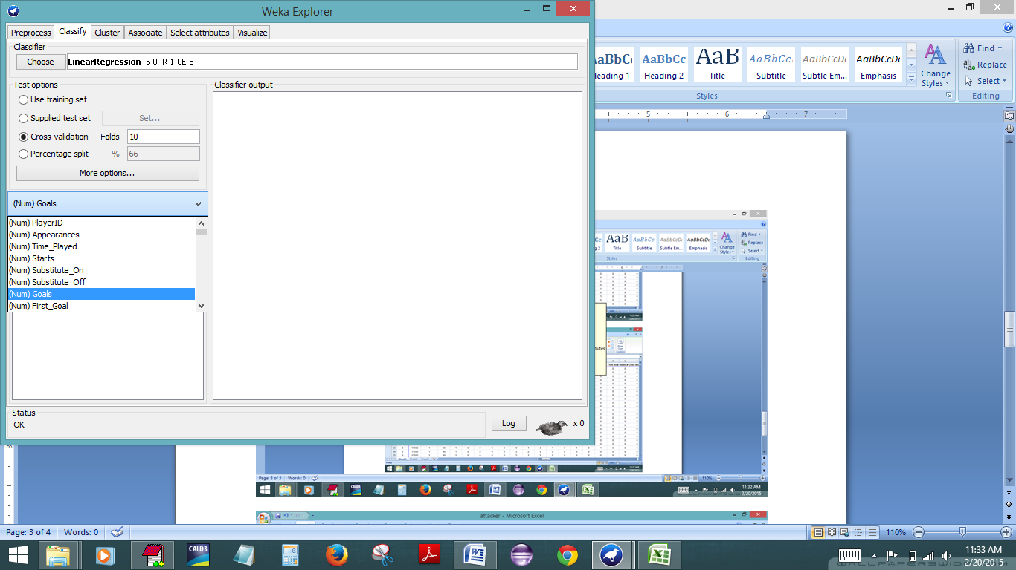

Slide 22
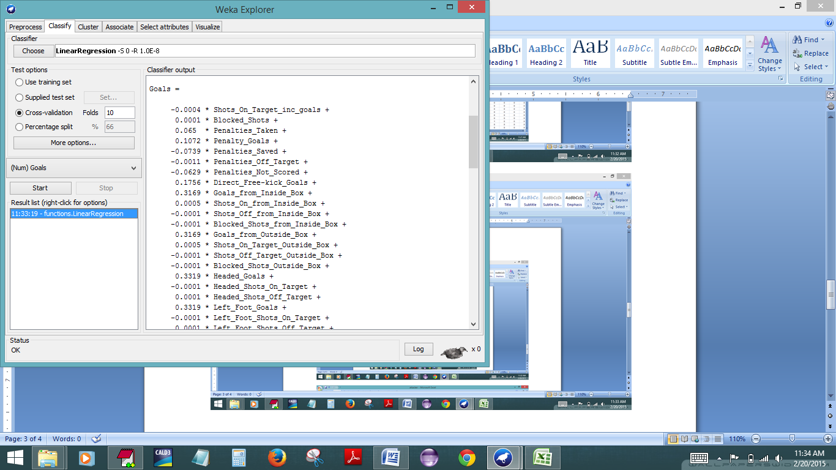

Slide 23
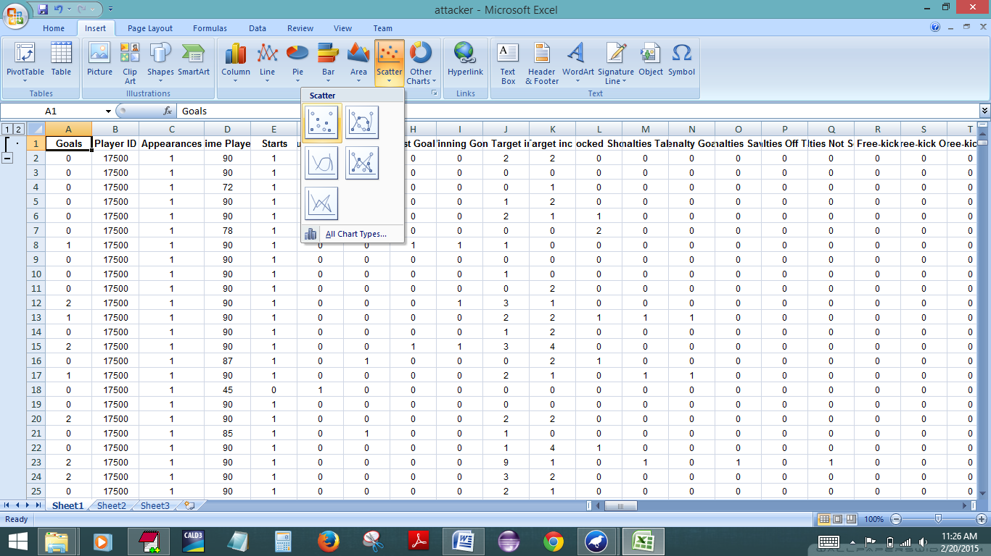

Slide 24
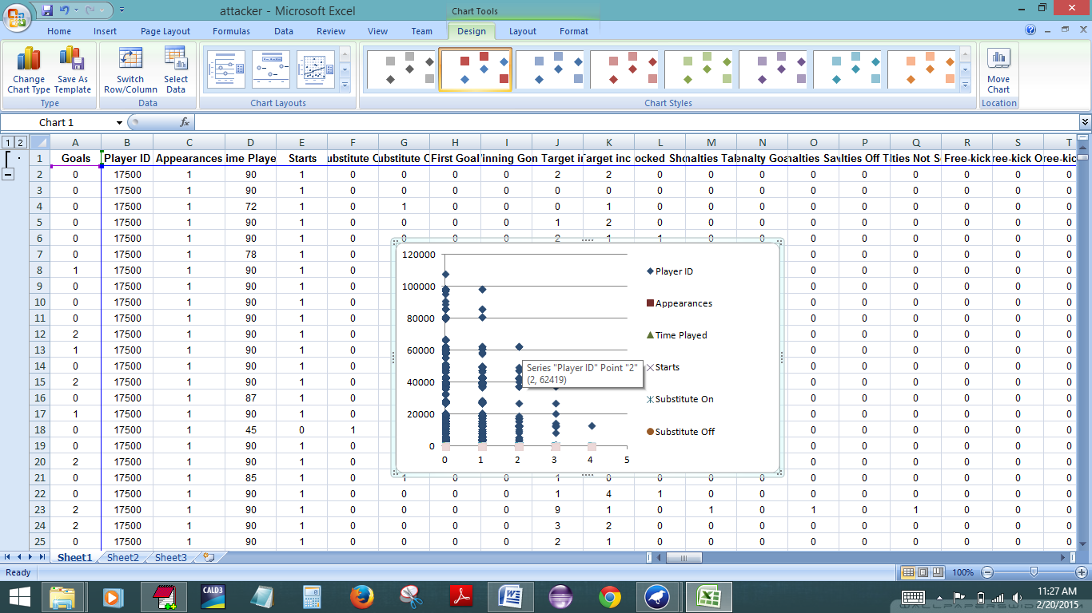

Slide 25
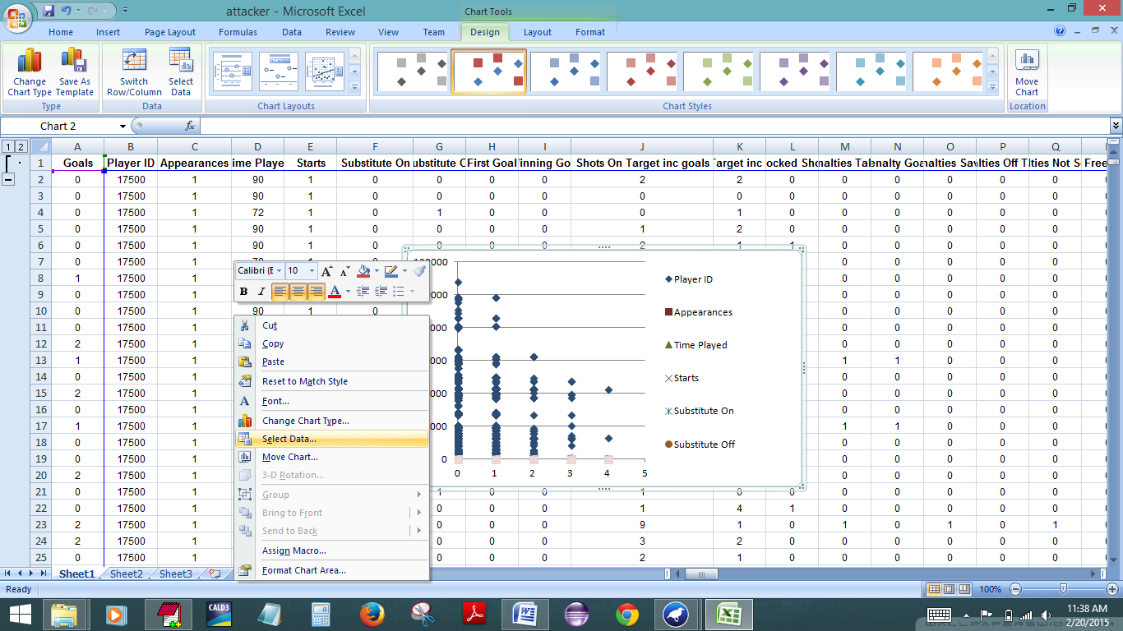

Slide 26
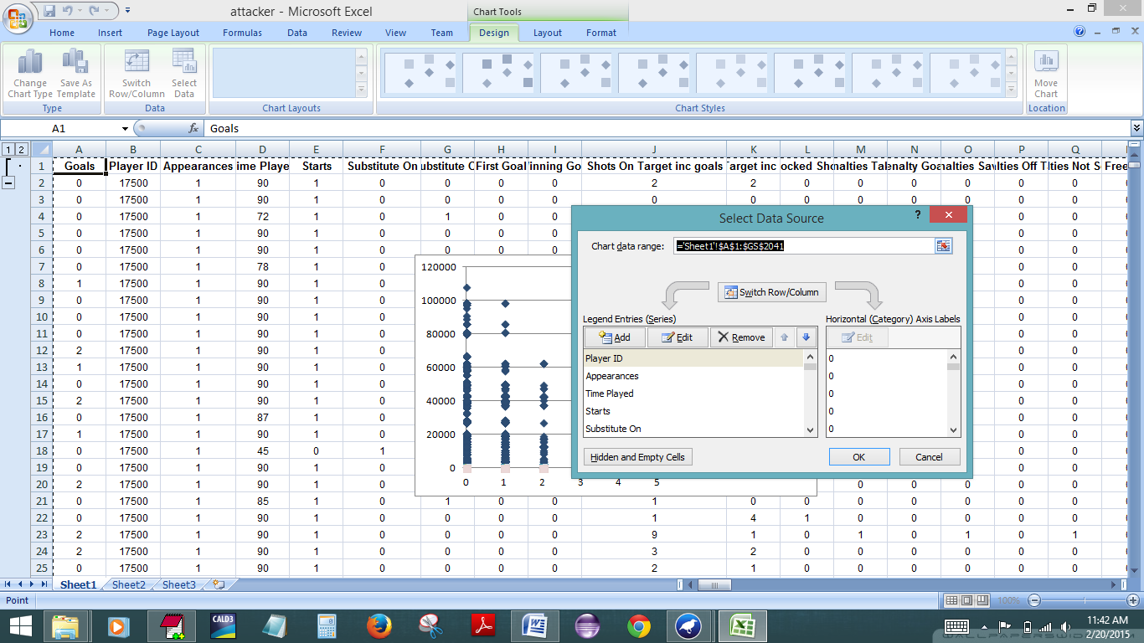

Slide 27
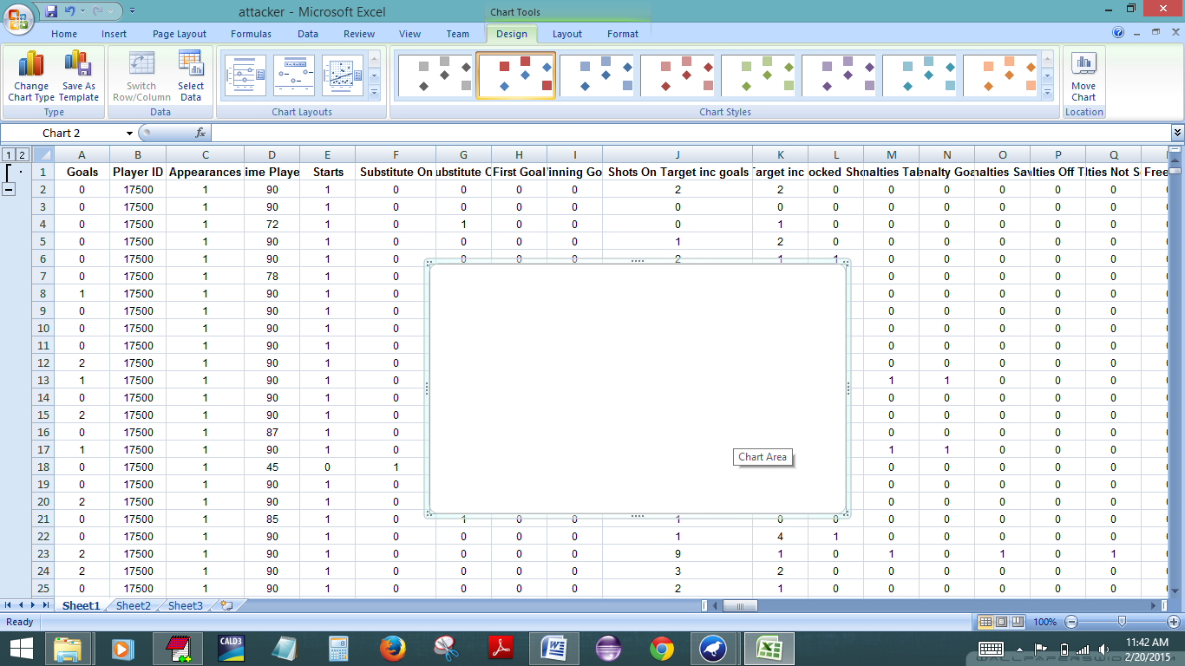

Slide 28
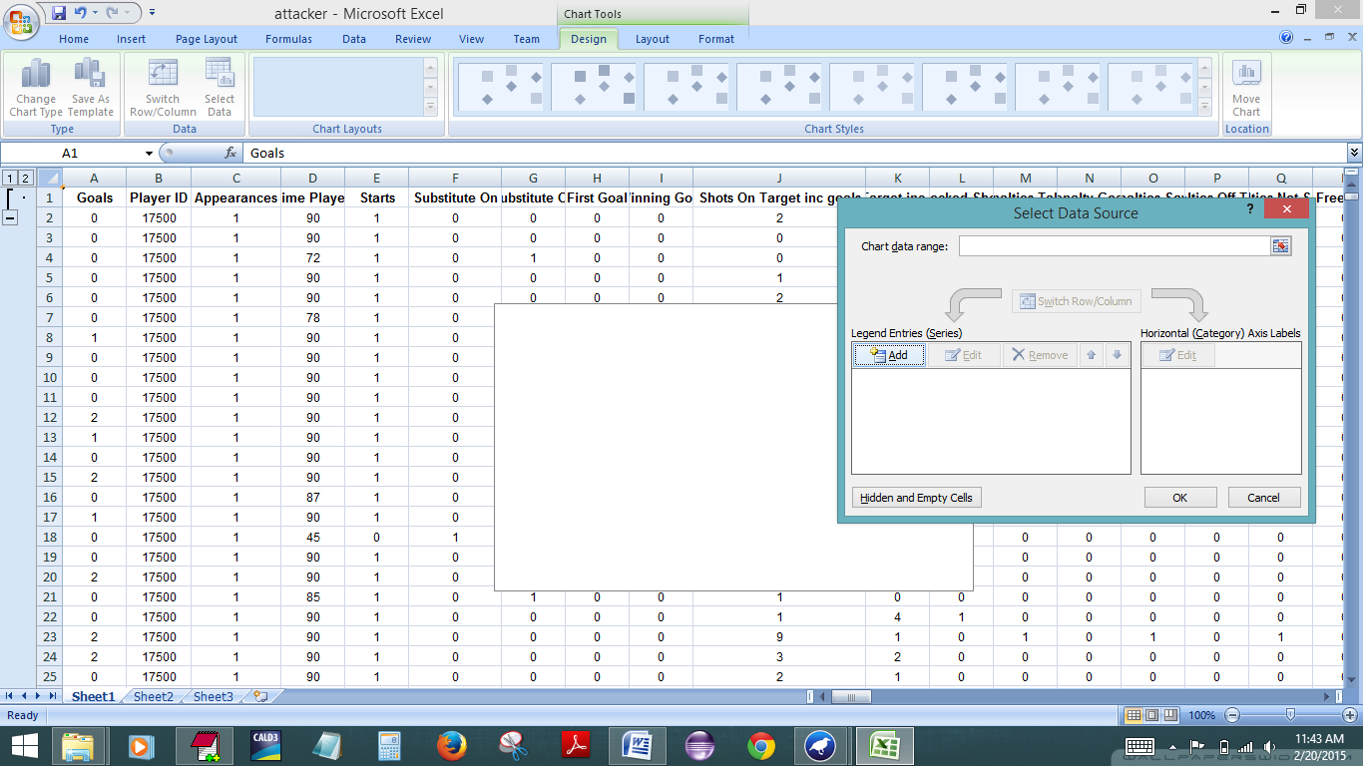

Slide 29
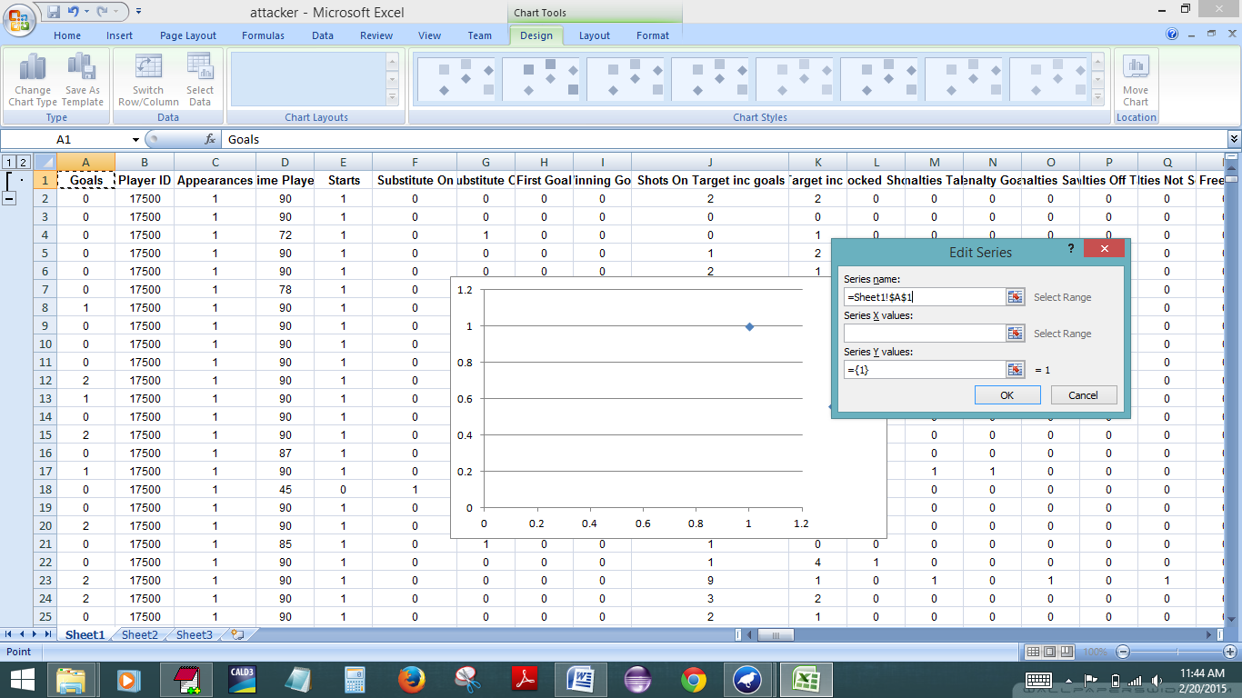

Slide 30
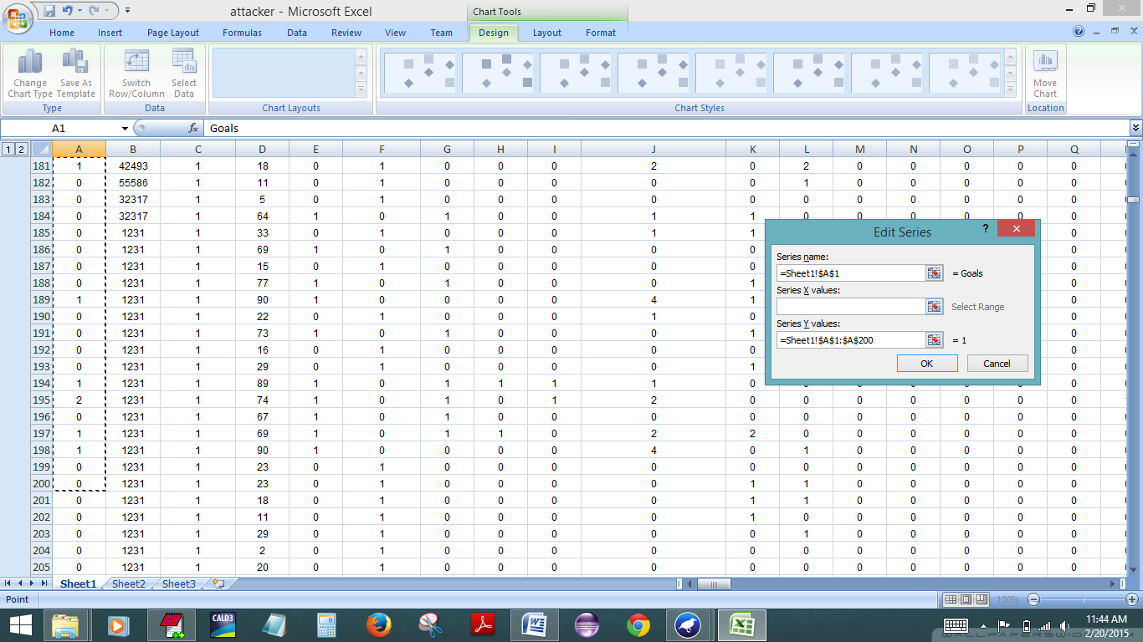

Slide 31
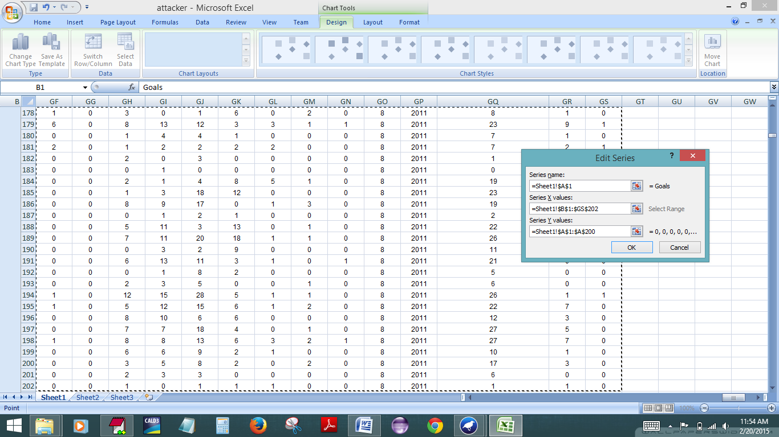

Slide 32
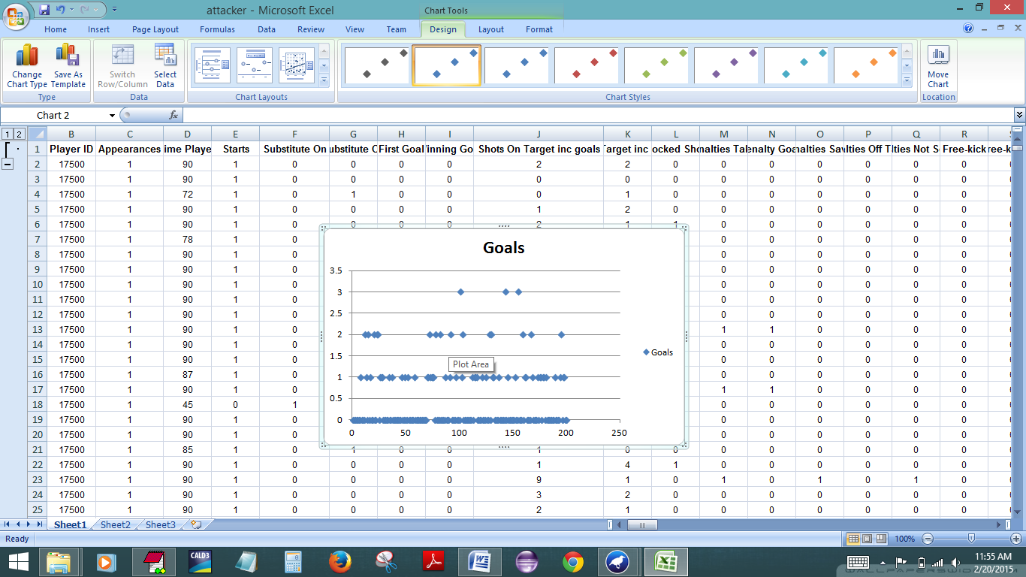

Slide 33
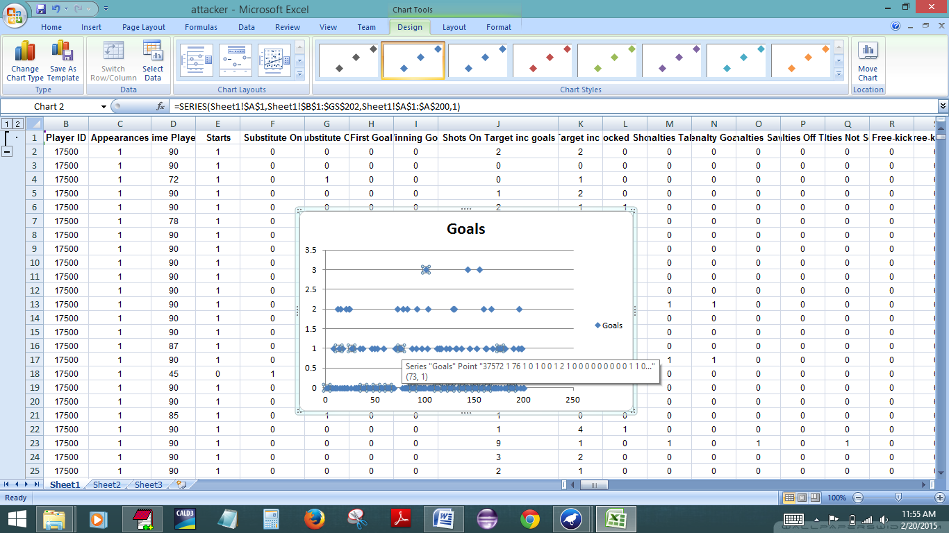

Slide 34
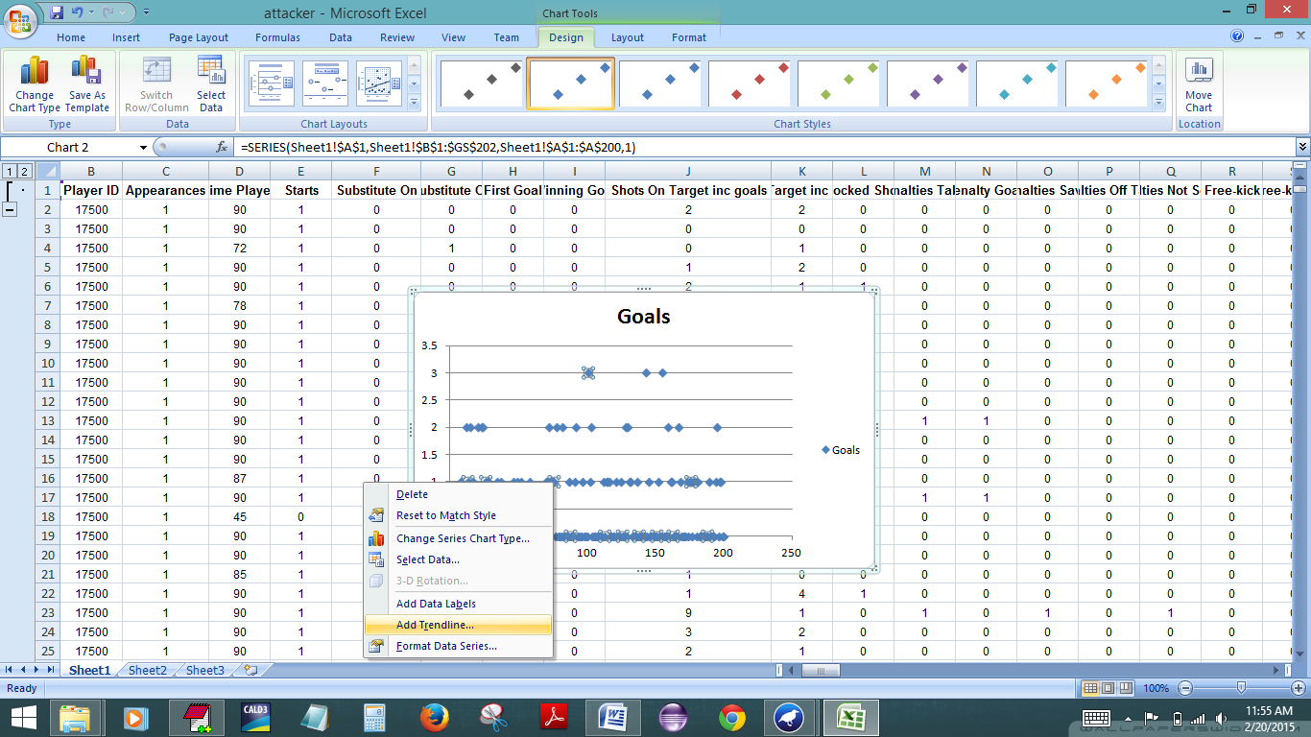

Slide 35
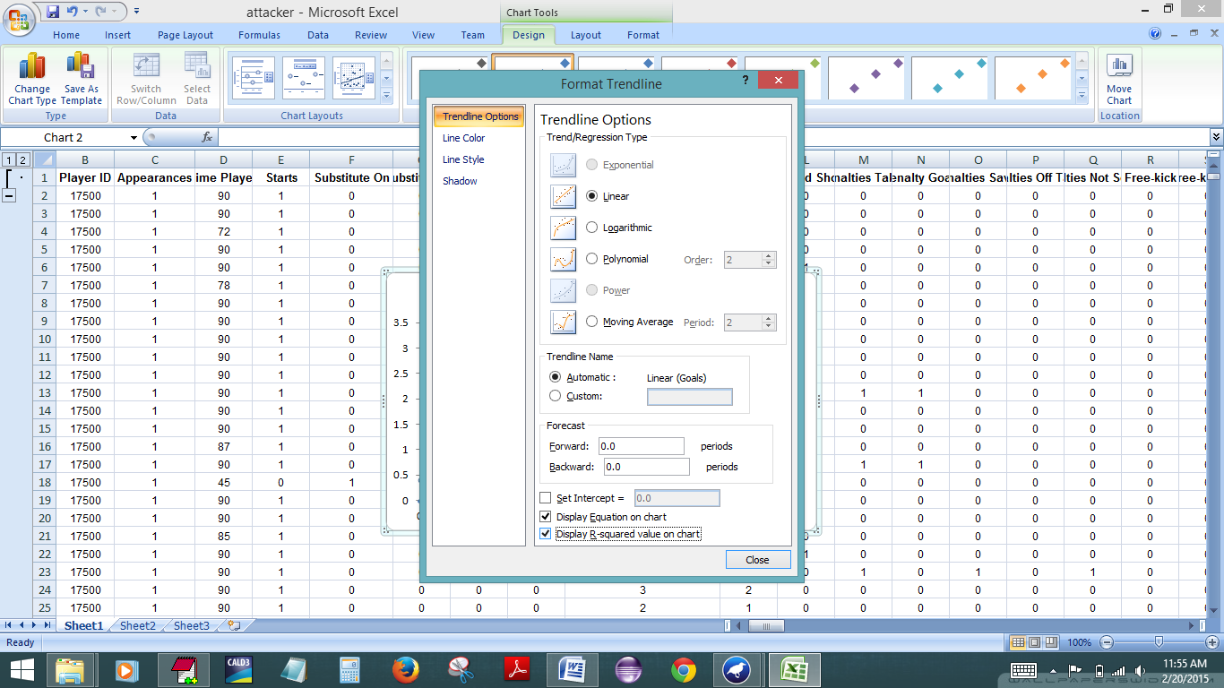

Slide 36
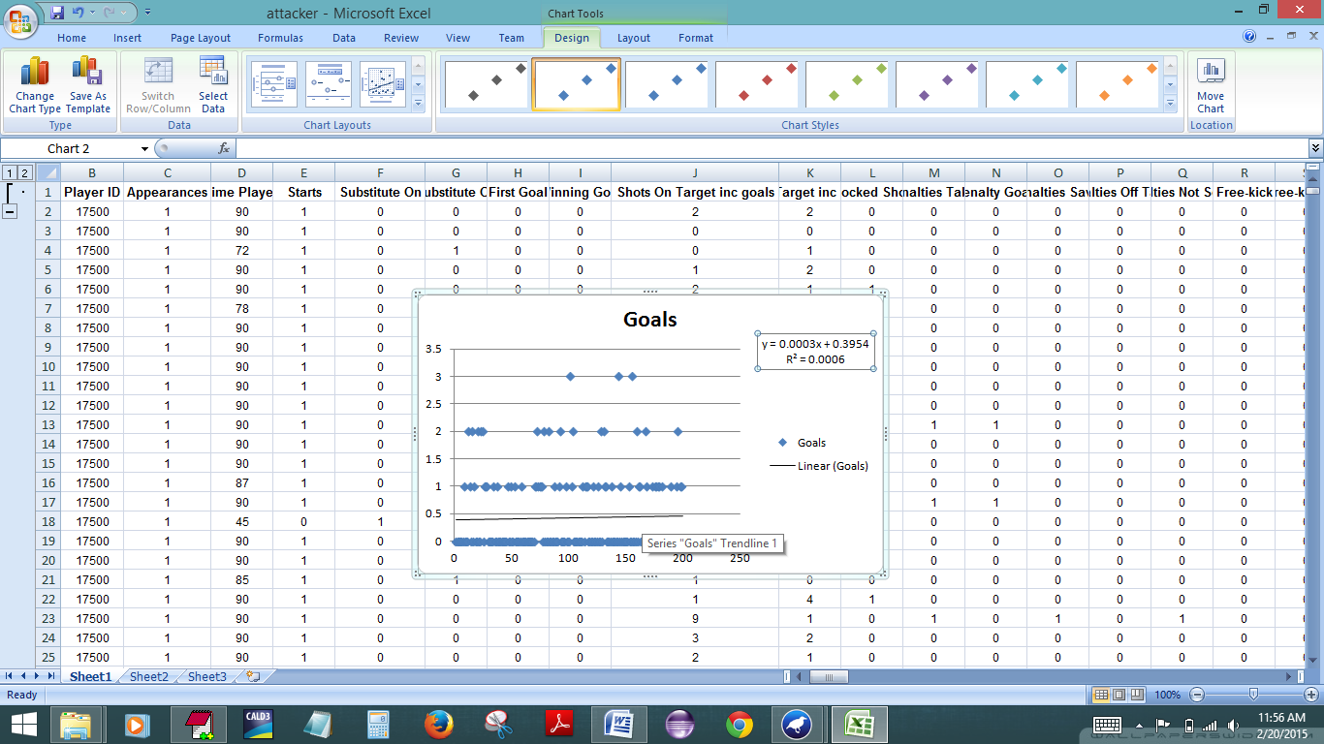

Slide 37
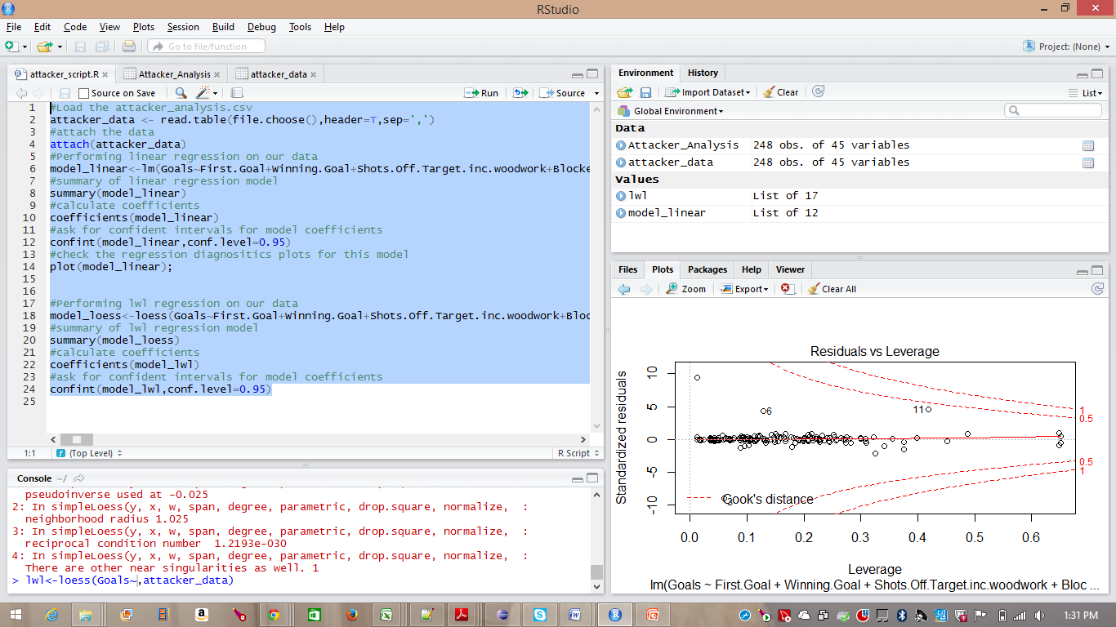

Slide 38
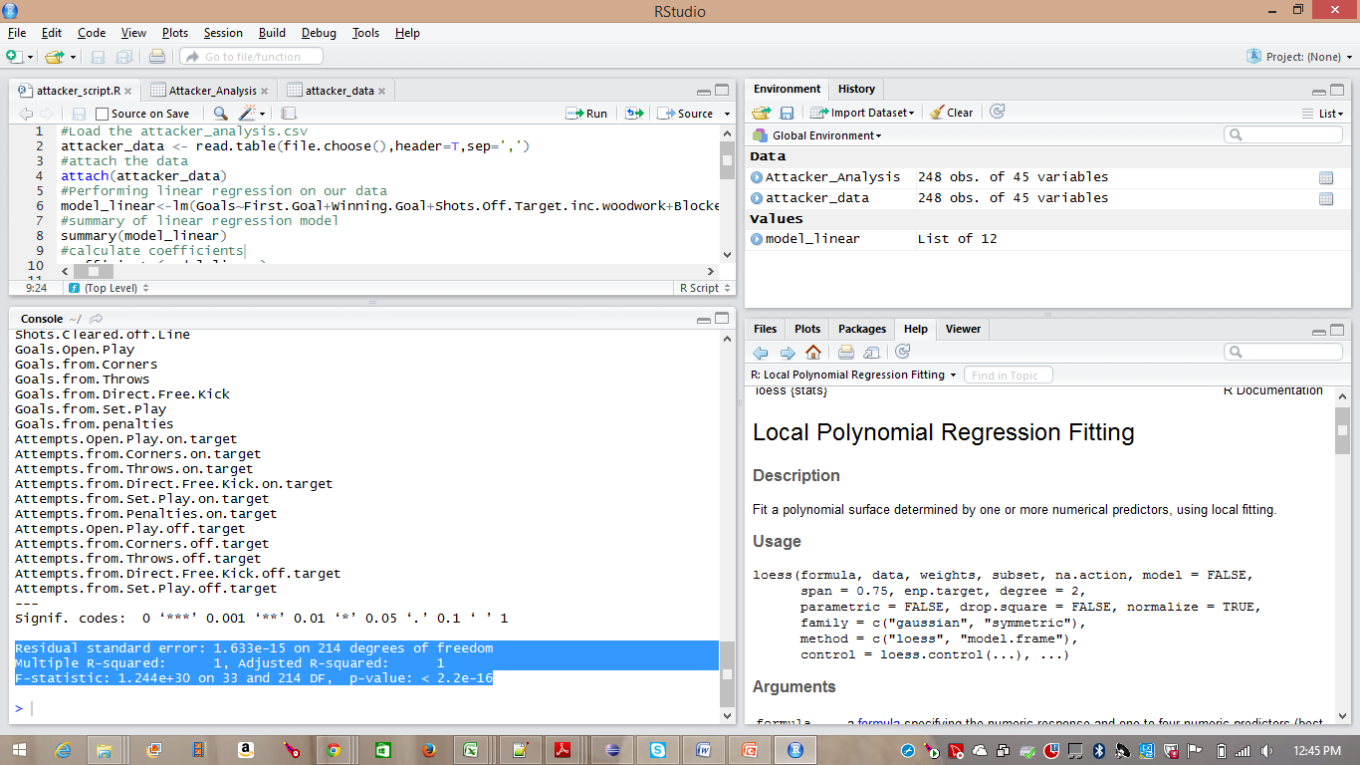

Slide 39
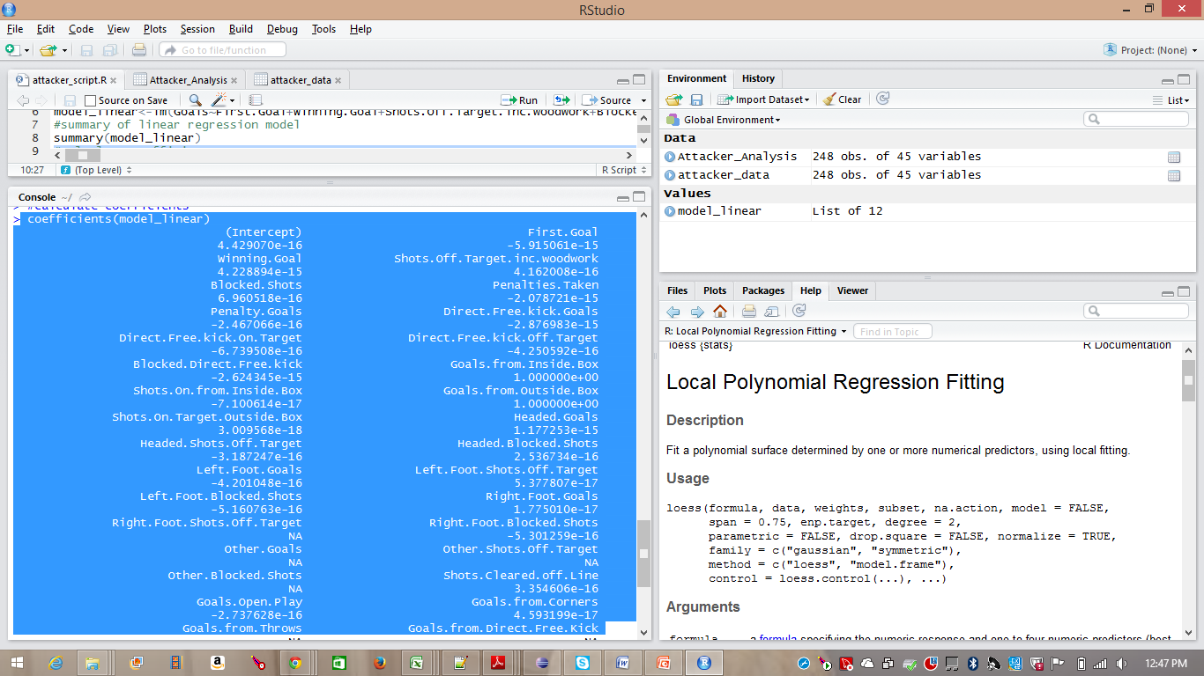

Slide 40
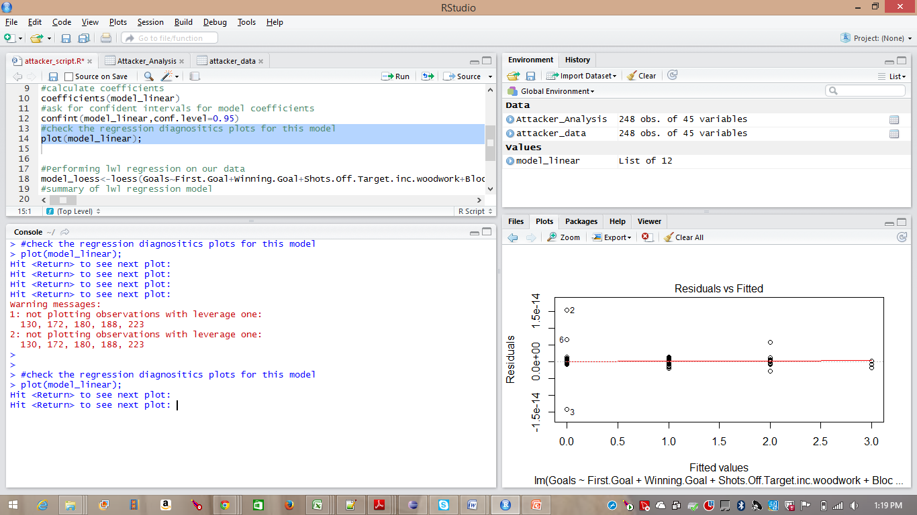

Slide 41
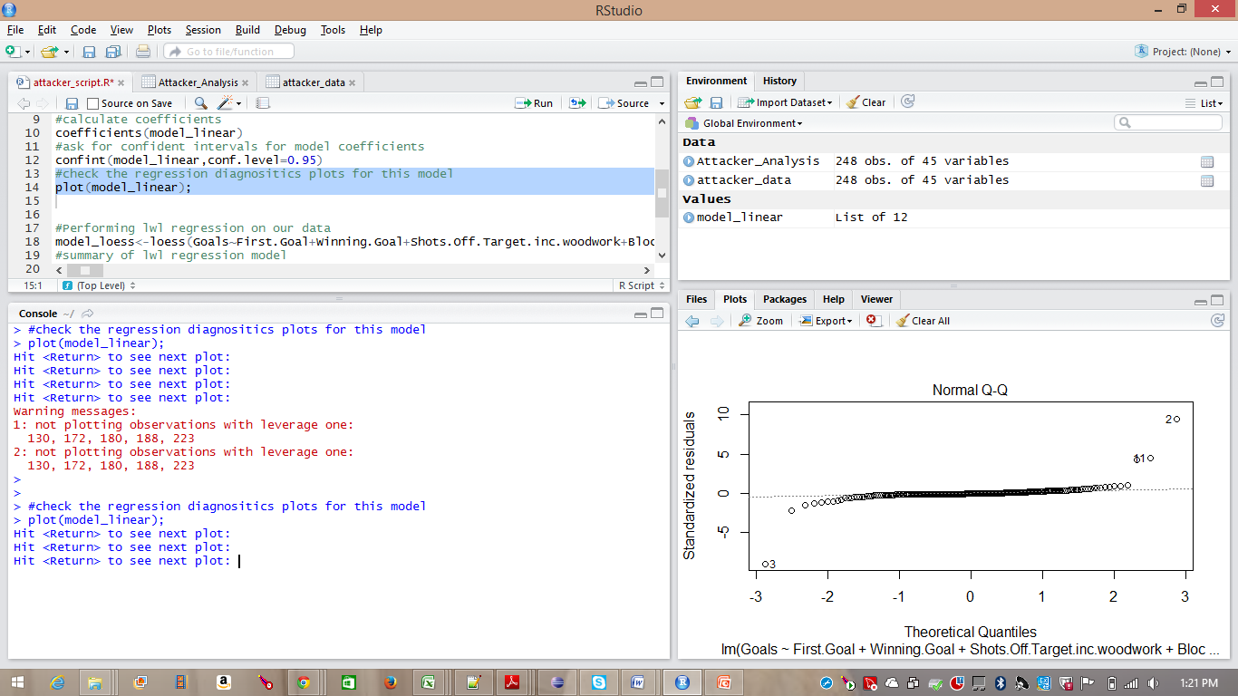

Slide 42
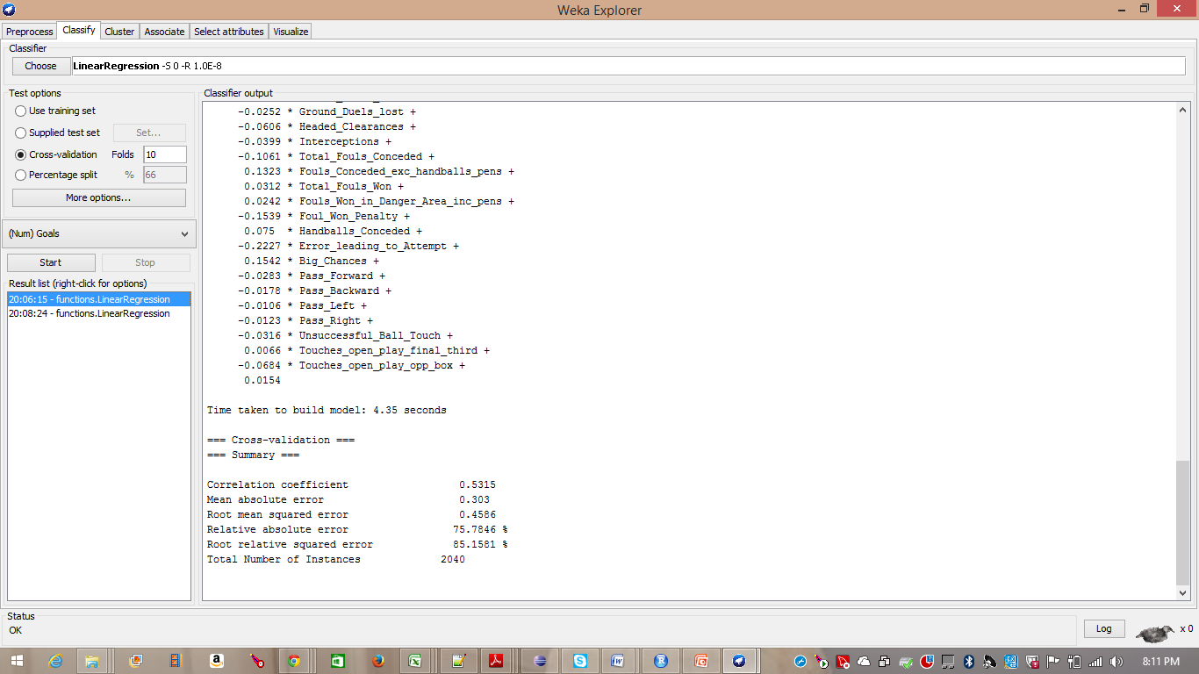

Slide 43
Results
Weka:-
Correlation coefficient : 0.5315
From 200 attributes only 44 attributes
Excel :-
Equation : y = -0.0003x +0.4326
R-square : 0.0009
R-
Multiple R-squared: 1
F-statistic: 1.244e+30 on 33 and 214 DF, p-value: < 2.2e-16
Residual standard error: 1.633e-15 on 214 degrees of freedom
(Intercept) :4.429e-16

Slide 44
Conclusion
Attributes

